Slide 1

Notes:
Debt free degree – there are no student fees to pay as these are covered by the employer and the UK government. This means that apprentices will have no need to get a student loan and will graduate without any student debt.
Full honours degree – degree apprentices are awarded a full honours degree alongside their apprenticeship which is exactly the same as a traditional degree in terms of value. Apprentices attend a graduation ceremony like all Aston students.
Professional experience – Apprentices will gain up to five years (depends on programme) of professional work experience as they will work for 80% of their time. This looks great on a CV and will set them apart from traditional graduates who typically have little valuable work experience.
Earn while you learn – apprentices are working full time so they get paid a full time salary as well as having no fees to pay. This is theirs to spend on whatever they want such as holidays, a car or getting their own place. Apprentices must be paid at least National Minimum Wage, but many employers offer more.

Slide 2
Our focus on apprenticeships in our tutor curriculum this week will include
Understand what are apprenticeships
Looking at which companies offer apprenticeships
Looking at different types of apprenticeship – including degree apprenticeships
Looking at real life apprenticeship case studies
Looking at how to research apprenticeship opportunities in your areas

Slide 3
The link below offers an 8 minute film about Apprenticeships – good for an introduction:
https://amazingapprenticeships.com/resource/the-apprenticeship-assembly-film/

Slide 4
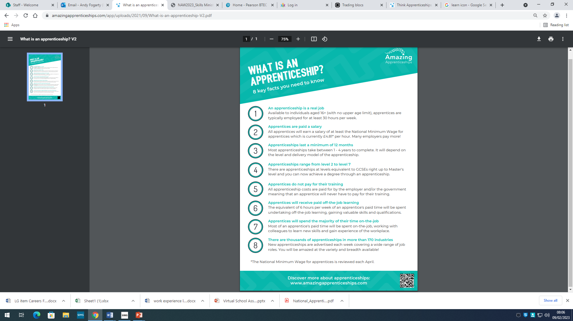

Slide 5








There are many companies who offer apprenticeships. Can you recognise any from their logo’s?
Crown Prosecution service
Dunelm
Barratt’s homes
John Lewis
BUPA
Morrison’s
B & Q
Jaguar Land Rover

Slide 6
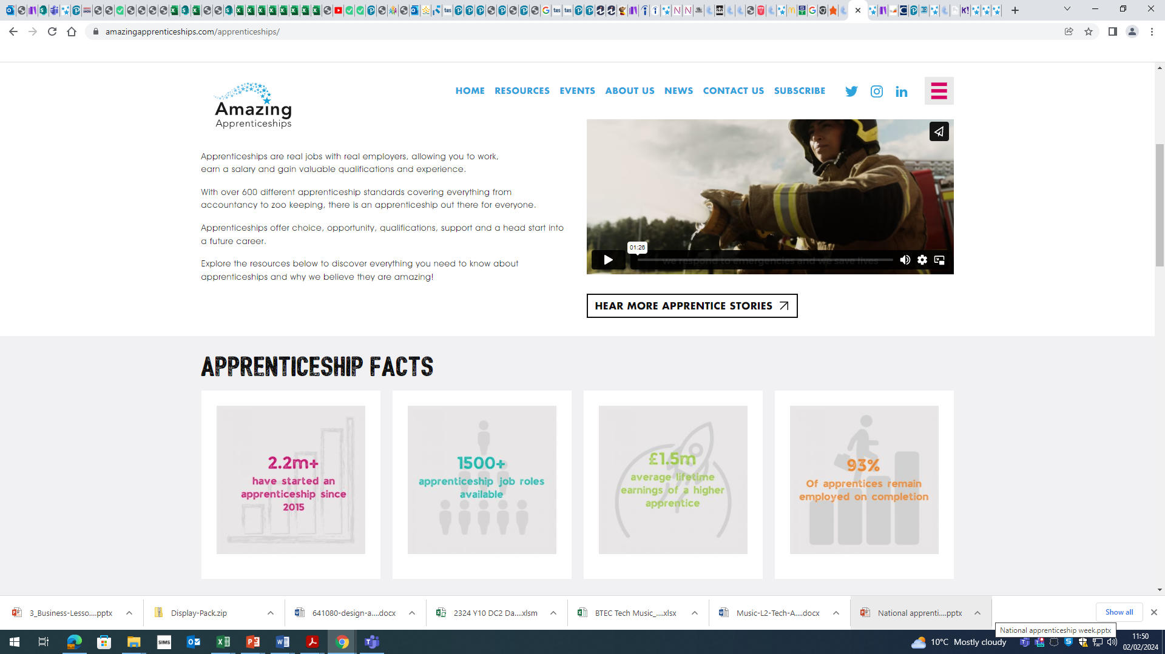
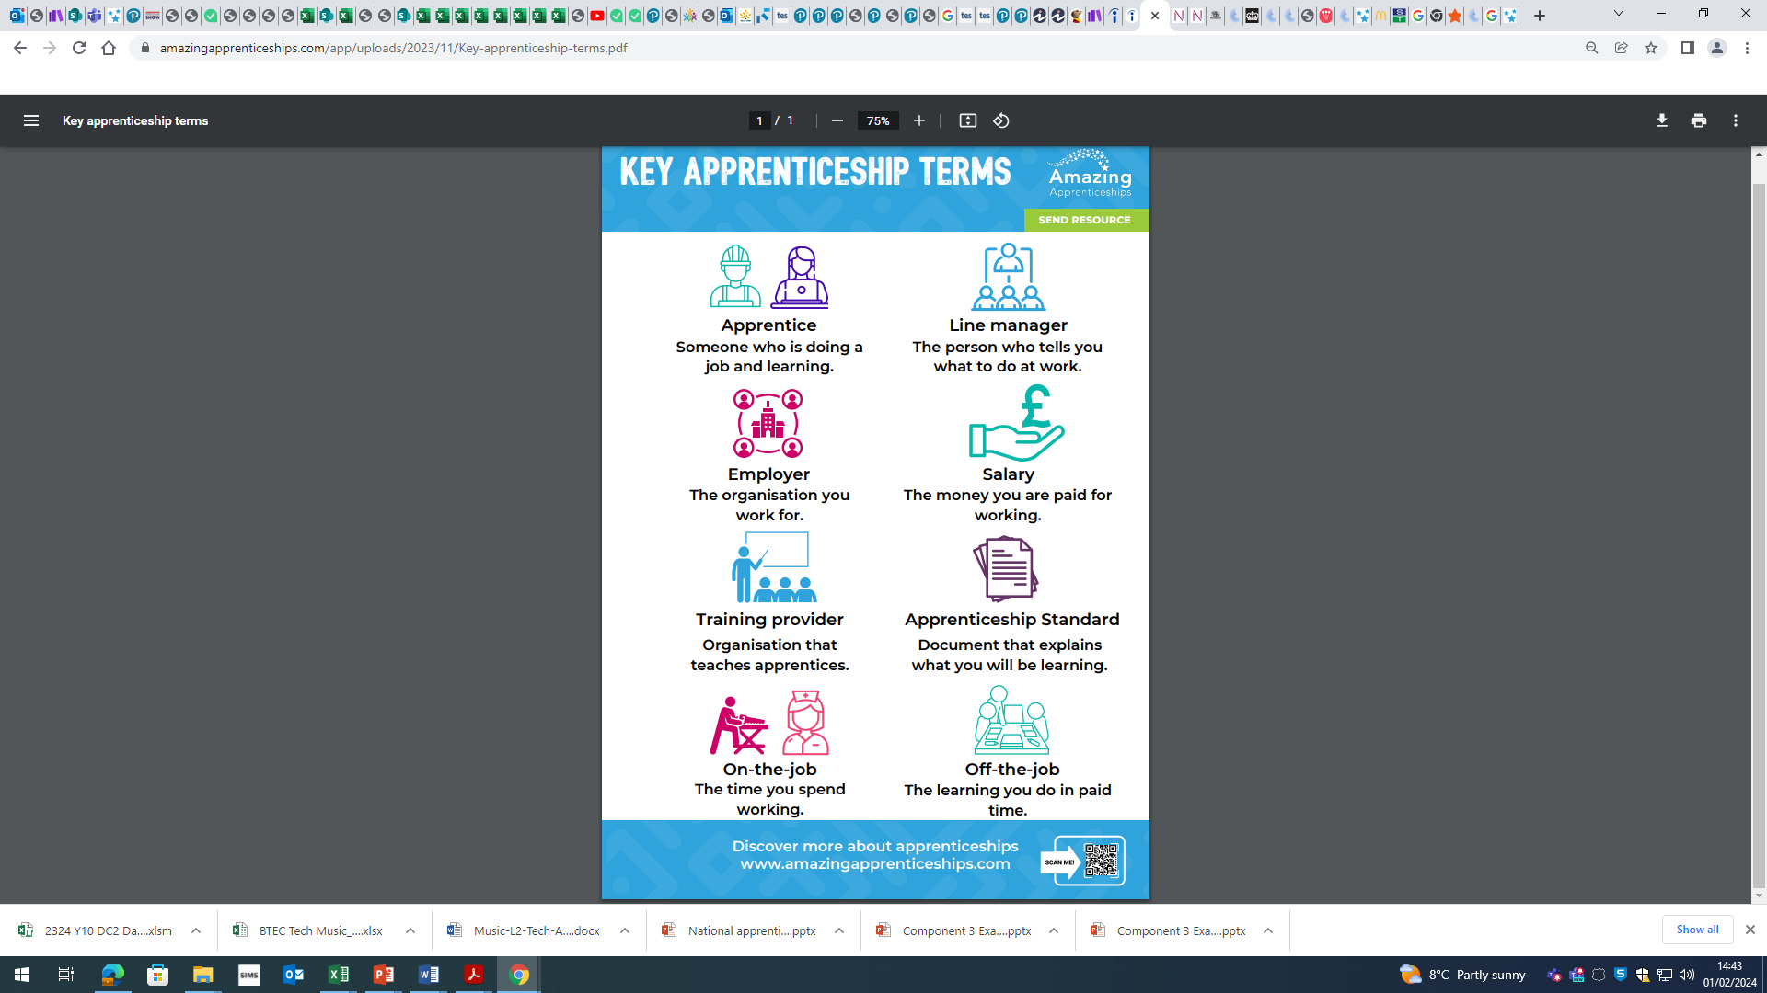

Slide 7
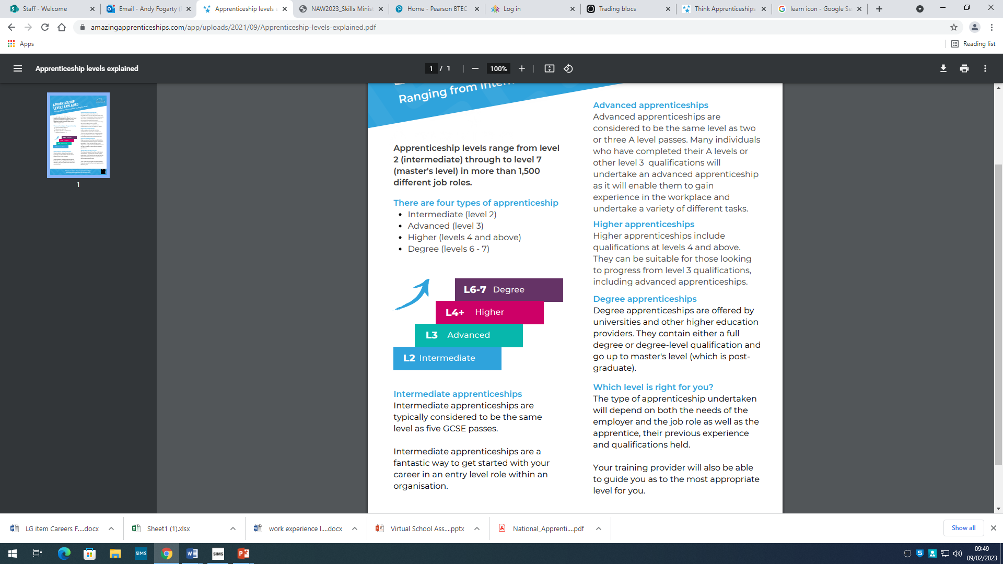

Different types of Apprenticeships:

Slide 8
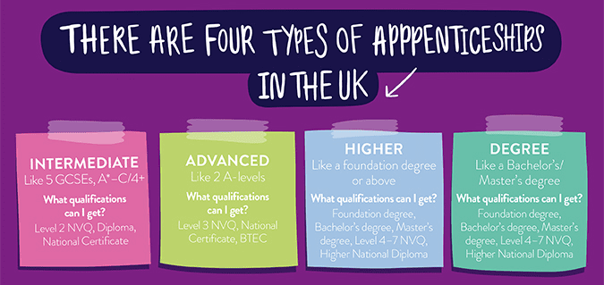
What are the different types of apprenticeship?
Applying after GCSE’s / Year 12 – Advanced apprenticeships
Applying once you have completed either A levels or Level 3 BTEC – Higher or Degree apprenticeships
Notes:
Debt free degree – there are no student fees to pay as these are covered by the employer and the UK government. This means that apprentices will have no need to get a student loan and will graduate without any student debt.
Full honours degree – degree apprentices are awarded a full honours degree alongside their apprenticeship which is exactly the same as a traditional degree in terms of value. Apprentices attend a graduation ceremony like all Aston students.
Professional experience – Apprentices will gain up to five years (depends on programme) of professional work experience as they will work for 80% of their time. This looks great on a CV and will set them apart from traditional graduates who typically have little valuable work experience.
Earn while you learn – apprentices are working full time so they get paid a full time salary as well as having no fees to pay. This is theirs to spend on whatever they want such as holidays, a car or getting their own place. Apprentices must be paid at least National Minimum Wage, but many employers offer more.

Slide 9
What is it like to study for an apprenticeship?
Apprenticeship case studies
Today we are going to look at some examples of apprenticeships in a wide range of subjects

Slide 10
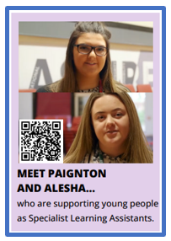
  Watch the video and answer the following questions:
  Why did they choose to do an apprenticeship?
  What aspects of an apprenticeship suited them as individuals?
  Do you relate to any of their experiences?
  Do you think completing an apprenticeship has been a success for them?
Click for the video

Slide 11
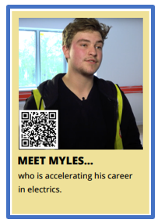
  Watch the video and answer the following questions:
  Why did they choose to do an apprenticeship?
  What aspects of an apprenticeship suited them as individuals?
  Do you relate to any of their experiences?
  Do you think completing an apprenticeship has been a success for them?
Click here for video

Slide 12
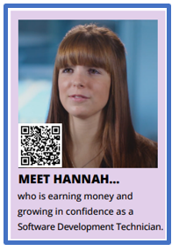
  Watch the video and answer the following questions:
  Why did they choose to do an apprenticeship?
  What aspects of an apprenticeship suited them as individuals?
  Do you relate to any of their experiences?
  Do you think completing an apprenticeship has been a success for them?
Click here for video

Slide 13

  Watch the video and answer the following questions:
  Why did they choose to do an apprenticeship?
  What aspects of an apprenticeship suited them as individuals?
  Do you relate to any of their experiences?
  Do you think completing an apprenticeship has been a success for them?
Click here for video

Slide 14
Some celebrity stories – some may be more relevant than others:
https://www.bbc.co.uk/bitesize/articles/z2vxnk7
6 examples

Slide 15
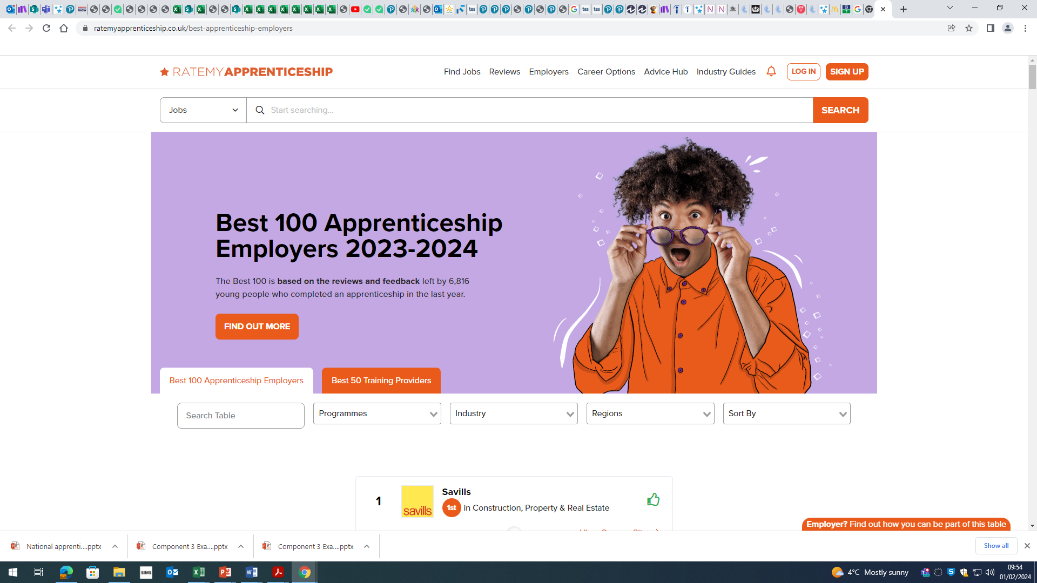
Use the link to see the top ten best rated employers:
https://www.ratemyapprenticeship.co.uk/best-apprenticeship-employers
It gives you a direct link to the employers careers website to learn more about what they can offer.

Slide 16

The top 100 best rated employers for apprenticeships 2023:
https://topapprenticeshipemployers.co.uk/files/Top100AE23.pdf
What is the professional services sector?
Professional service providers offer expert support to businesses of all sizes and sectors.
They include lawyers, advertising professionals, architects, accountants, financial advisers….

Slide 17
Quizzes – to do as a group or individually
https://create.kahoot.it/profiles/ac19c67f-aa3a-4722-9670-a3238d5fa6ea
Best ones are:
Apprenticeship basics
Apprenticeship facts
Logos
Celebrities
Take on the apprenticeship quiz to see what skills are required and what roles are available:
https://amazingapprenticeships.com/resource/naw2021-which-apprenticeship-am-i-quiz/
https://www.bbc.co.uk/bitesize/articles/zrggwsg

Slide 18
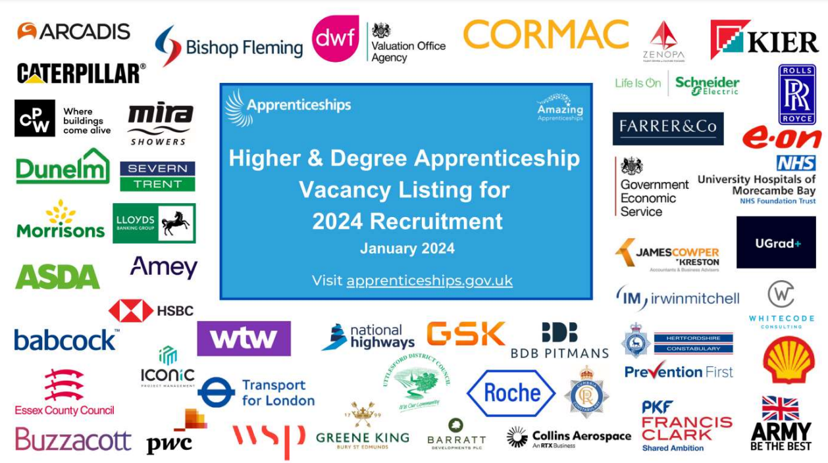
Latest offerings for higher & degree apprenticeships:
https://amazingapprenticeships.com/app/uploads/2023/10/Higher-and-Degree-Vacancy-Listing-for-2024-PowerPo.pdf

Slide 19
Can you think of any other factors?
Some key factors will influence your search criteria
Do you want to stay at home or are you happy to move away for your dream apprenticeship?
Do you drive / have access to a car? If you have passed your test and have a car you can drive, your search area will widen, opening up more opportunities.
The area of apprenticeship you are looking for – some types of apprenticeship are only found in certain areas of the country

Slide 20

How can you find out which apprenticeships are available?
Today we are going to do some searches together so you can see how to search for an apprenticeship
Firstly go to https://www.gov.uk/apply-apprenticeship
Click on the green arrow to begin

Slide 21
How can you find out which higher apprenticeships are available?
Put in the school postcode CV6 4GL or (or use current location)
Search for higher apprenticeships in your tutor group and click on at least one example to find out the following:
Duration of apprenticeship
Salary
Qualifications you will receive on completion of the apprenticeship
How you will receive your training
Compare the number of apprenticeships within 5 miles and 15 miles – what do you notice?

Slide 22
How can you find out which Degree apprenticeships are available?
Put in the school postcode CV6 4GL or (or use current location)
Search for Degree apprenticeships in your tutor group and click on at least one example to find out the following:
Duration of apprenticeship
Salary
Qualifications you will receive on completion of the apprenticeship – which university is it accredited to?
How you will receive your training
Compare the number of apprenticeships within 5 miles and 15 miles – what do you notice?

Slide 23
True or False?
1. You have to choose between getting a degree or doing an apprenticeship.
FALSE – Degree apprenticeships allow you to work and study for a degree at the same time
2. You are paid for doing an apprenticeship, it is a real job that enables you to earn while you learn.
TRUE – An apprenticeship is real job, you learn at the same time as working and are paid.

Slide 24
True or False?
3. At the end of your apprenticeship you have to start paying back your student loan.
FALSE – You won’t have a student loan, the cost of your training is covered by the government and your employer.
4. All apprenticeships take two years to complete.
FALSE – An apprenticeship can take anywhere between 1 year up to 6 years, depending on the role and apprenticeship level. All apprenticeships are a minimum of 1 year
5. As an apprentice you are entitled to holiday pay and benefits.
TRUE – An apprentice gets the same benefits as any other employee.

Slide 25
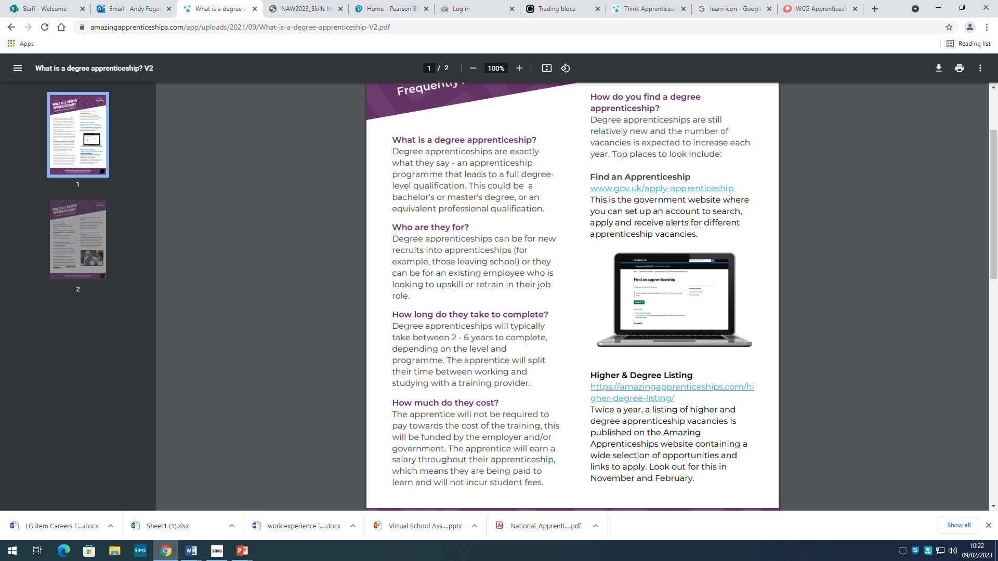
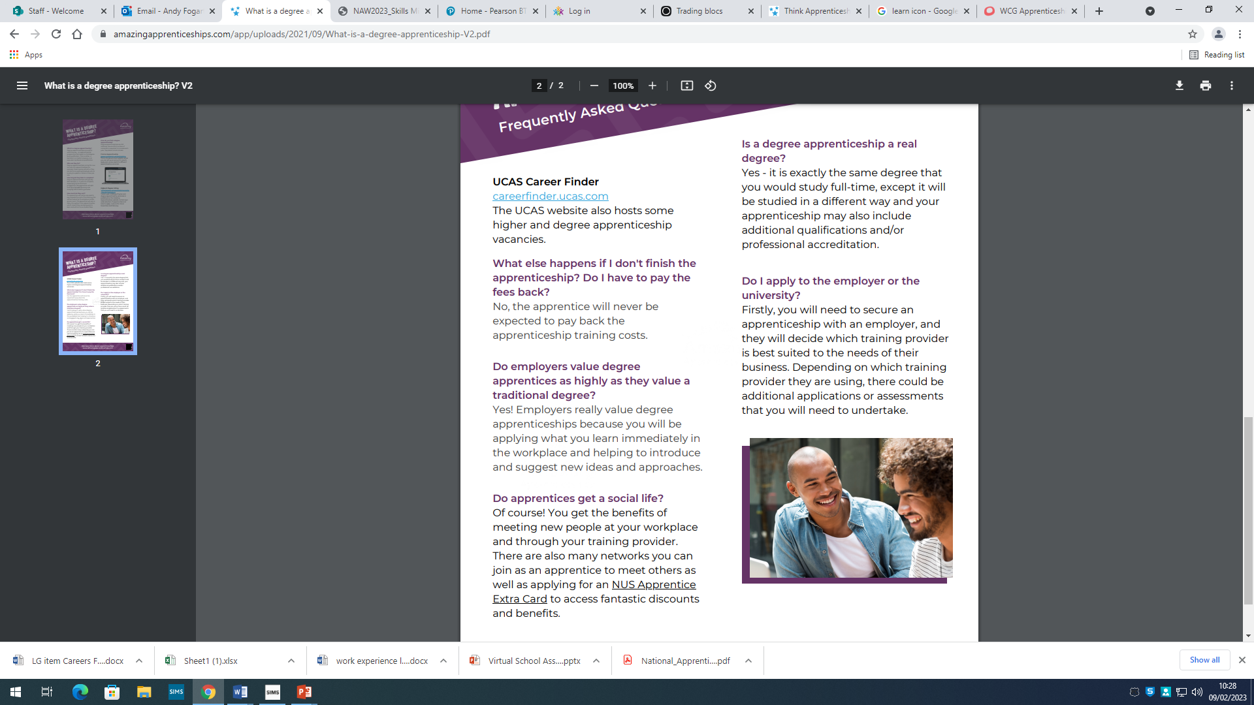
Degree Apprenticeships – myths and facts:

Slide 26
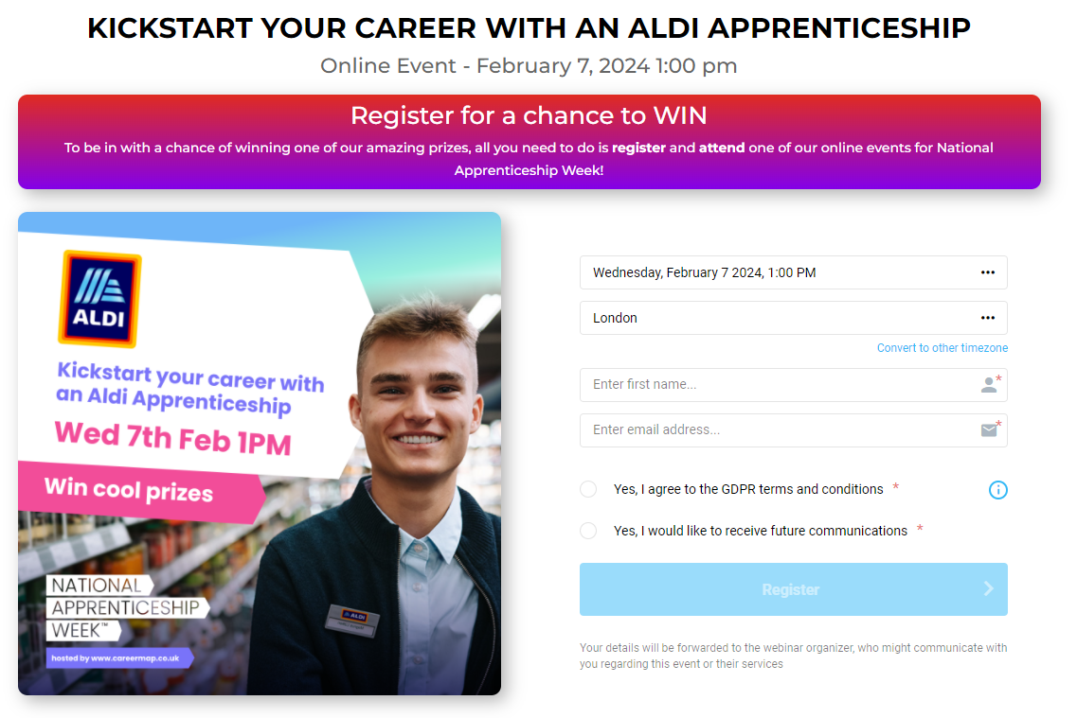


Slide 27



Find out more about apprenticeships!
Scan the QR codes to find out more
Apprenticeships.gov.uk
Apply for apprenticeship vacancies through
Find an Apprenticeship

