Slide 1
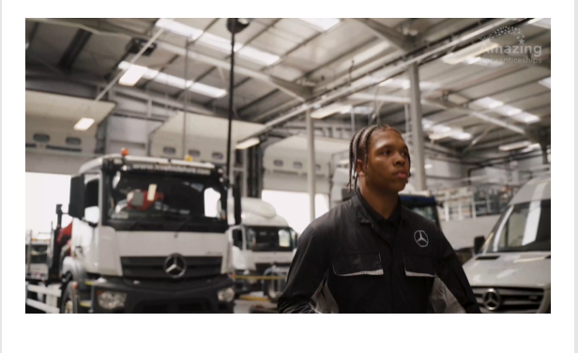
Learn about Apprenticeships National Apprenticeship week: 06/02 – 12/02
https://amazingapprenticeships.com/apprentice-stories/

Slide 2
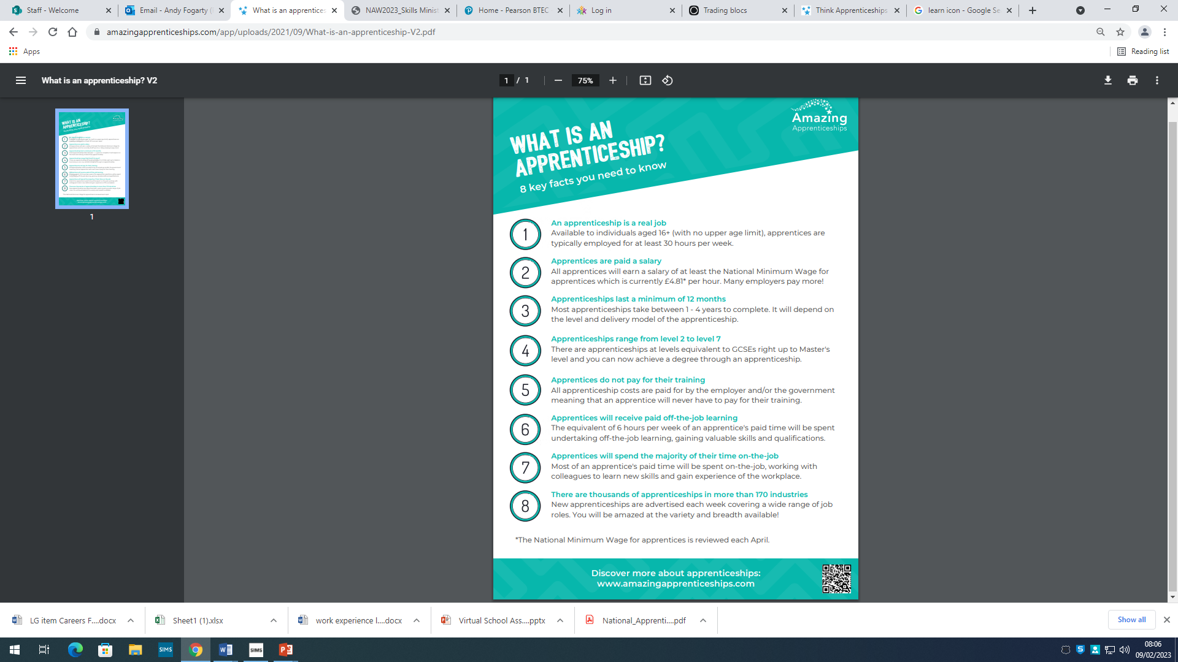
Facts about apprenticeships:

Slide 3
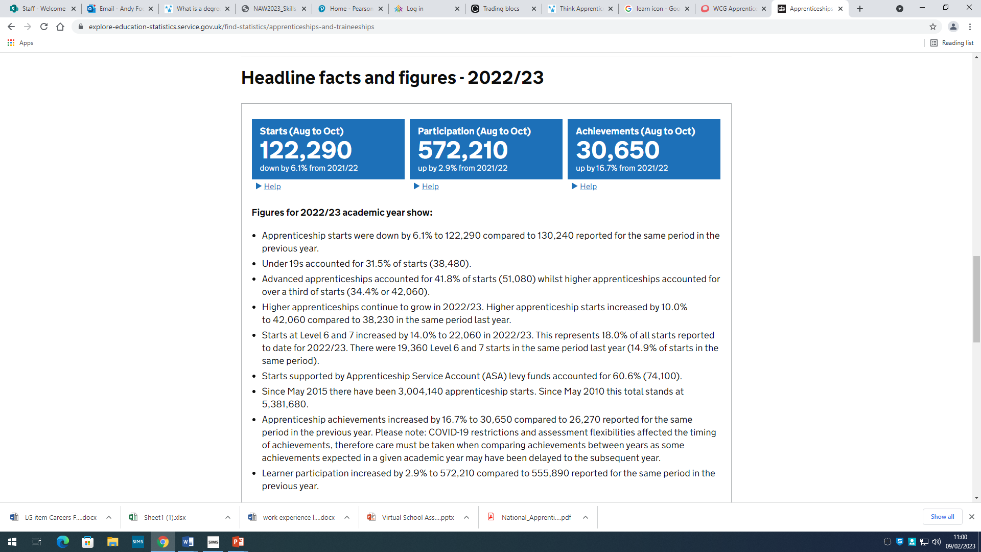
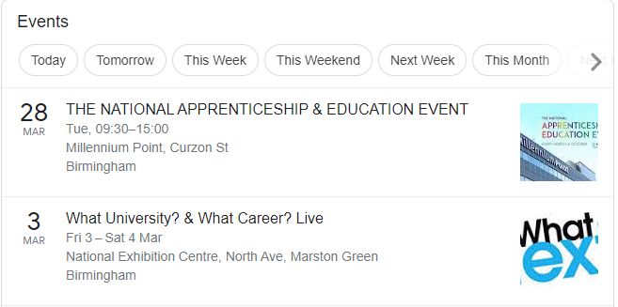
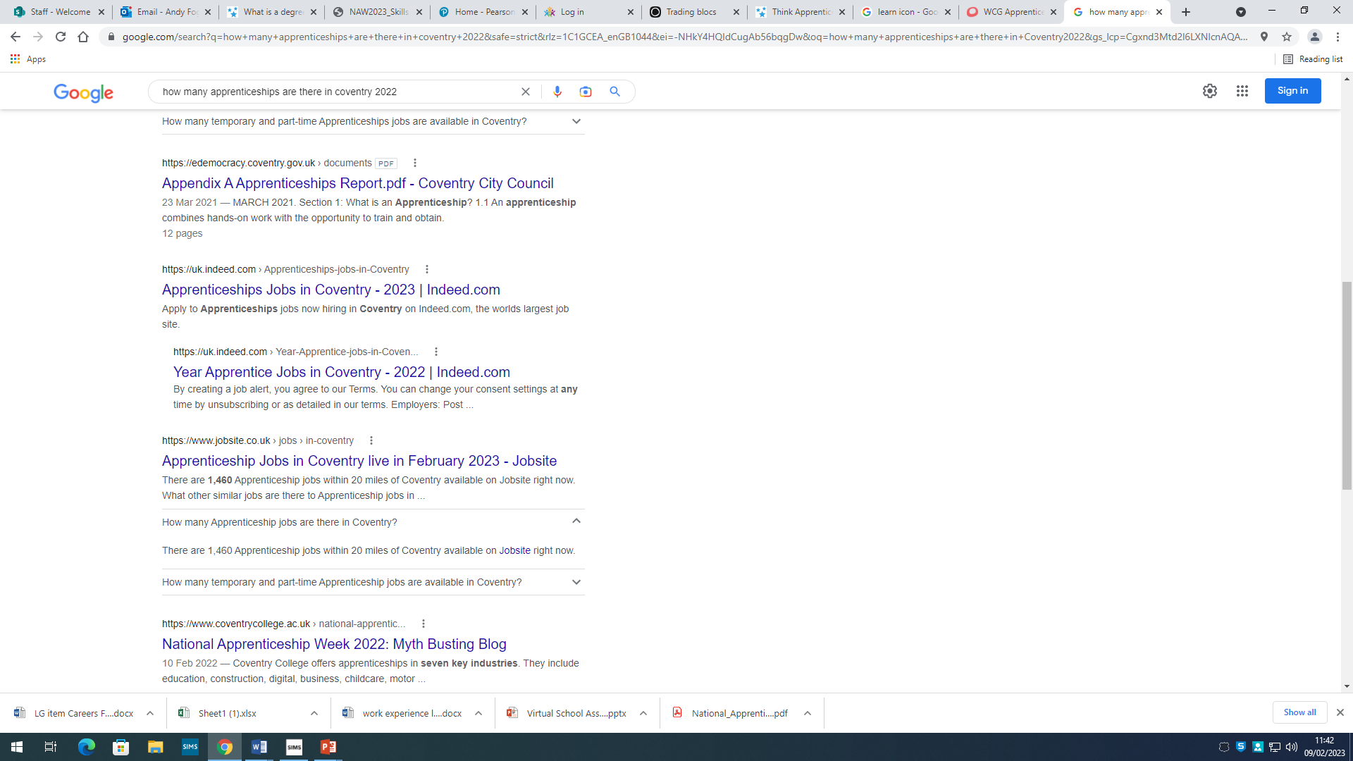
Some key information
You would have spoken to providers when you attended your careers fair before Christmas.
National Apprenticeship Week:
06/02-12/02.
Some key events coming up.

Slide 4
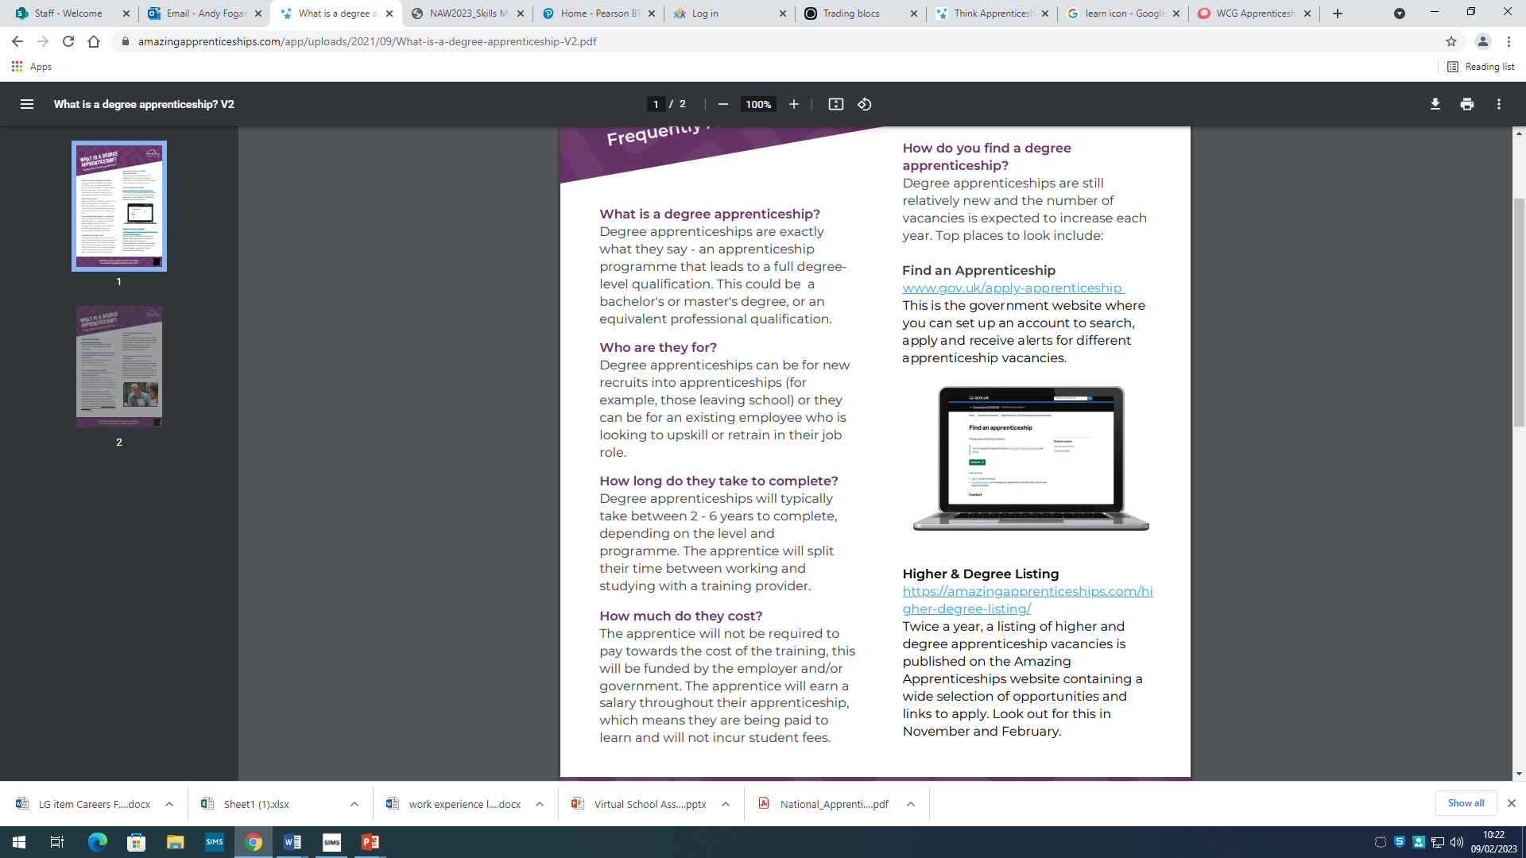
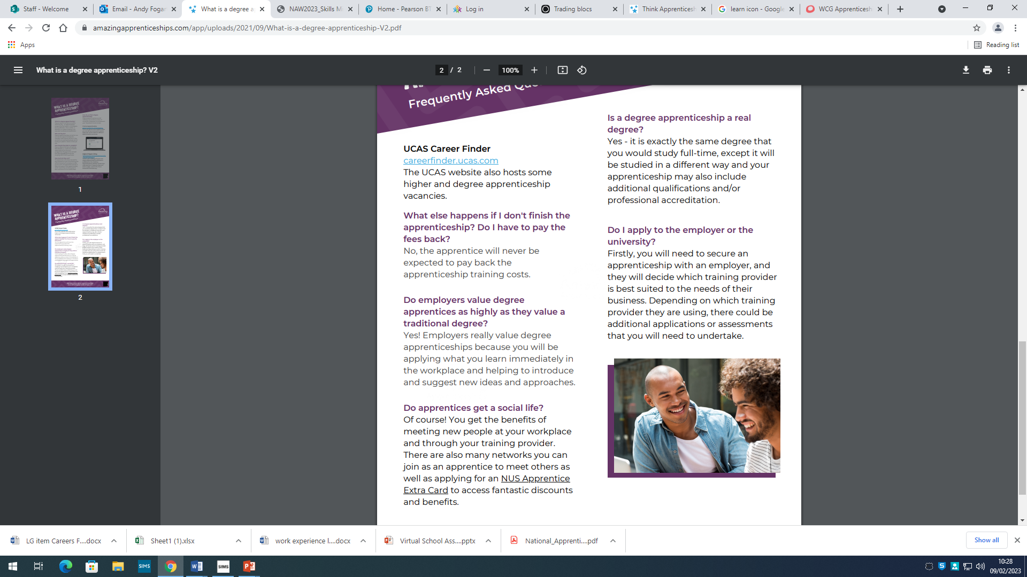
Useful websites to explore:
https://www.apprenticeships.gov.uk/#
Help to find a live apprenticeship in your area on the government website.
https://wcg.ac.uk/apprenticeships
One of the largest and most successful apprenticeship providers in the UK.
https://amazingapprenticeships.com
Helpful site to find out key information about different types of apprenticeships.

Slide 5
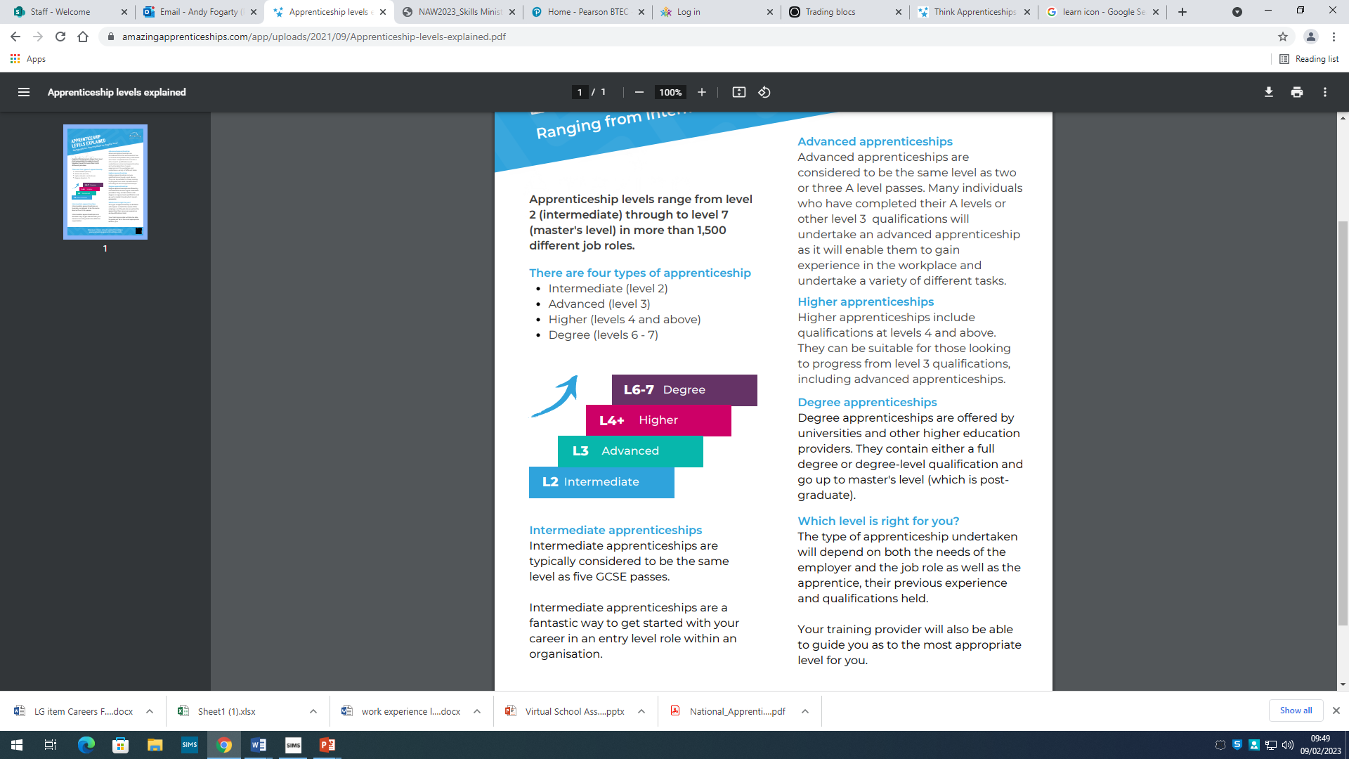

Different types of Apprenticeships:

Slide 6
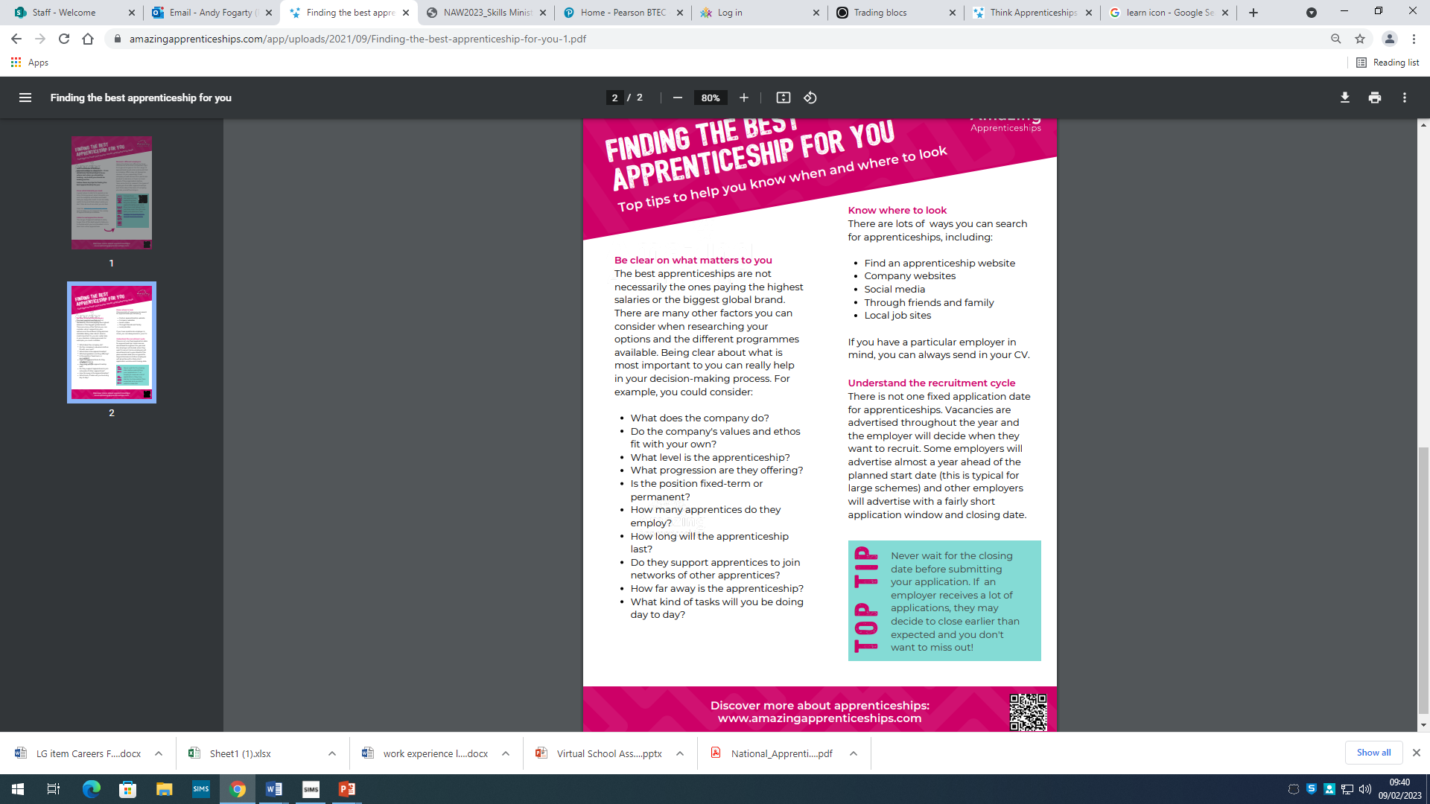
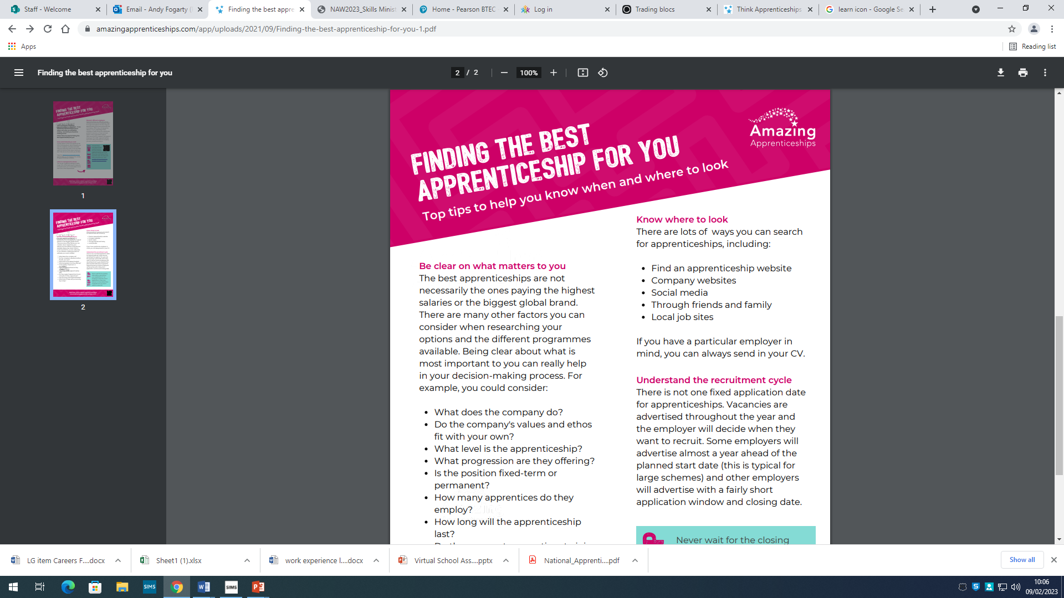
Top tips to finding an Apprenticeship:

Slide 7
Degree Apprenticeships – myths and facts:

Slide 8
What apprenticeships are out there & are they suitable for you?
Take on the apprenticeship quiz to see what skills are required and what roles are available:
https://amazingapprenticeships.com/resource/naw2021-which-apprenticeship-am-i-quiz/

